Slide 1

PROGRAMMING FUNDAMENTALS
FALL 2023

Slide 2

WEEK 3
UNDERSTAND STRUCTURE OF C PROGRAM
COMMENTS
LEARN AIRTHMETIC OPERATIONS

Slide 3
semester system
credit hours/ grades
warnings
concept of pre req
intro to degree
intro of students
intro to course
importance of course
marks distribution
class rules
LEC 1
Already done !

Slide 4
COVERED IN LAST WEEK
how to communicate with computer
Programming Language
C,C++,java, PHP, python, ruby, java script, C#
Classification of programming languages
high level : easy to understand by human
mid level: symbolic languages -> assembly language
low level language :machine level -> binary -> 01
e.g. if(age>17)
in high level , how it is in middle level and how it is in low level
Source file.
LEC 2
google class room code
course content
intro of teacher
tentative course outline
course books
Class Policy & Etiquette
CLO's
computer hardware
switches on/ off
transistor , IC's
Already done !

Slide 5
COVERED IN WEEK 2
LEC 3 & 4
How C runs
Understand problem solving
Algorithms
Already done !

Slide 6
STRUCTURE OF C PROGRAM
#include<stdio.h>
int main()
{
printf(“Hi Welcome to C”);
return 0;
}

Slide 7
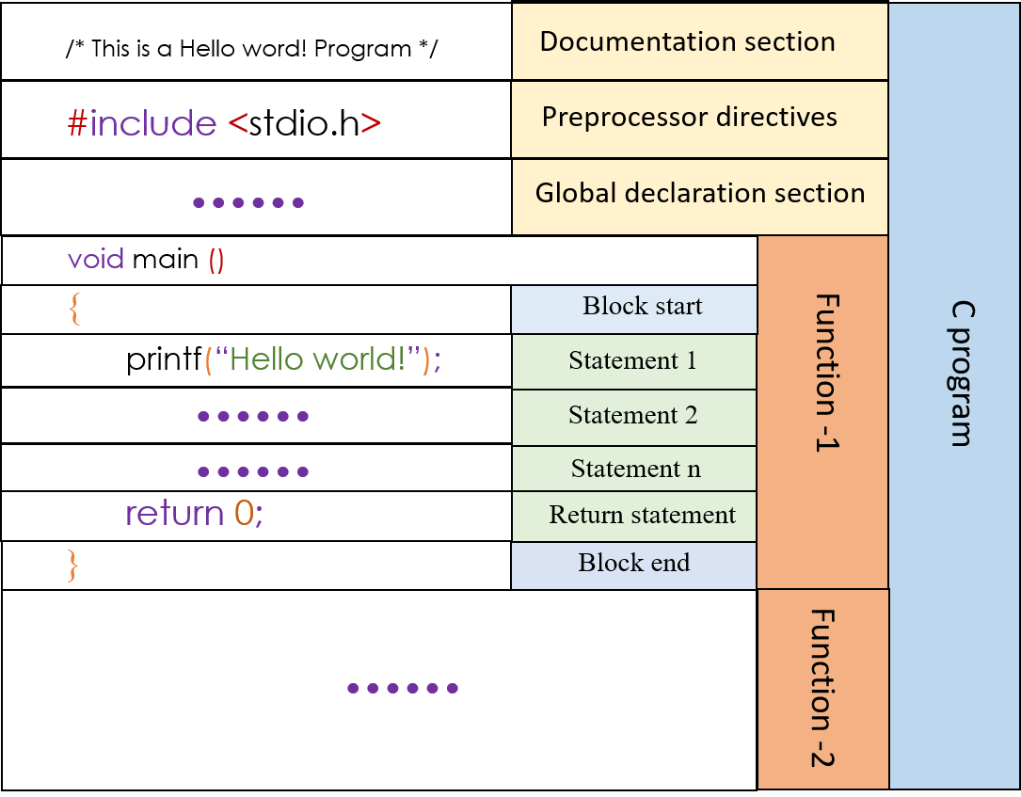

Slide 8
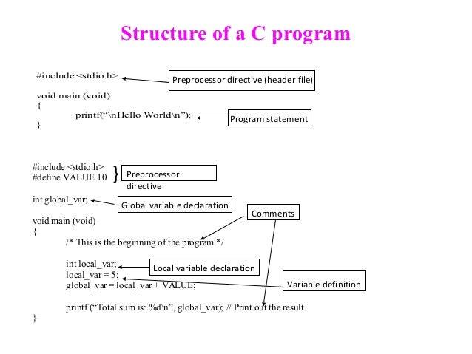

Slide 9
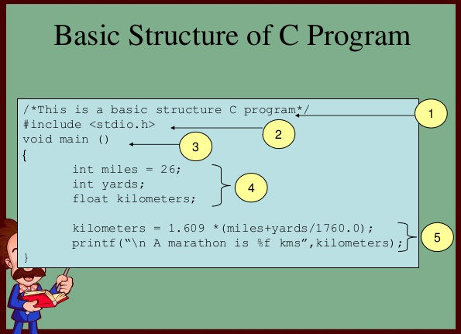

Slide 10
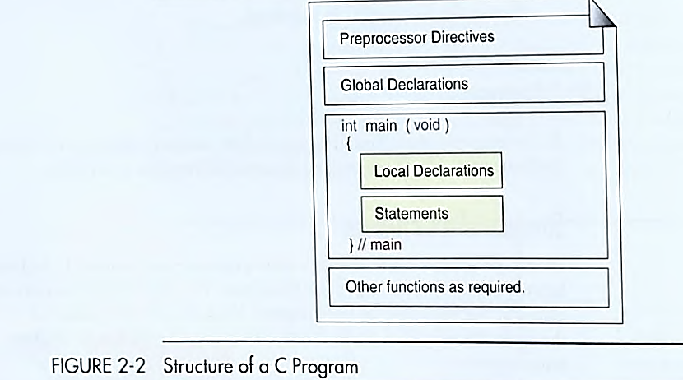

Slide 11
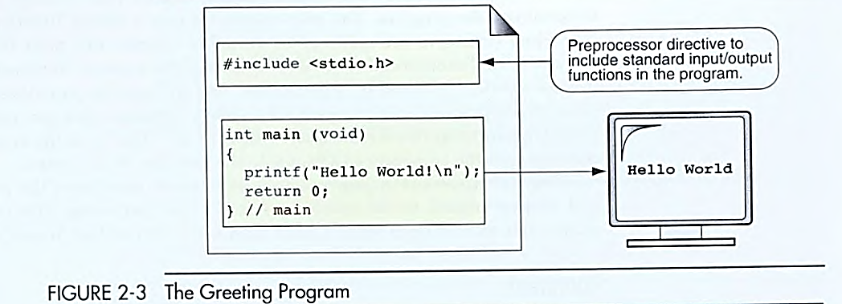

Slide 12
VARIABLES ?

Slide 13


Slide 14
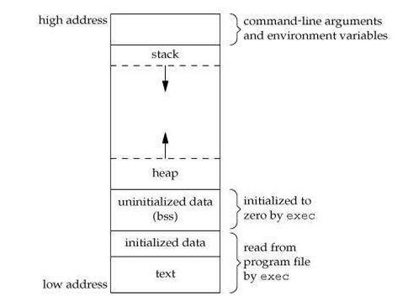
WON’T DIVE INTO IT
AT THE MOMENT !
BUT WHEN NEEDED…

Slide 15
WEEK 3 (LEC 4)

Slide 16
comments
The compiler ignores the comments when it translates the program into executable code.
A block comment is used when the comment will span several lines.
Purpose of comments
Comments are for ?
What to write in comments ?
How many comments
Single line comment
Whole line comment
Partial line comment
Multiline comments /block comment
Nested comments ???

Slide 17
CONSTANT
A constant is declared similarly to variables, except it is prepended with the const keyword, and you always need to specify a value.
const int AGE = 37;
A constant name follows the same rules for variable names: can contain any uppercase or lowercase letter, can contain digits and the underscore character, but it can't start with a digit. AGE and Age10 are valid variable names, 1AGE is not.
Another way to define constants is by using this syntax:
#define AGE 37
We won’t use this, REASONS LATER ON !

Slide 18
AIRTHMETIC OPERATORS & Assignment operators
+
-
*
/
%
( )
++
--
=
+=
-=

Slide 19
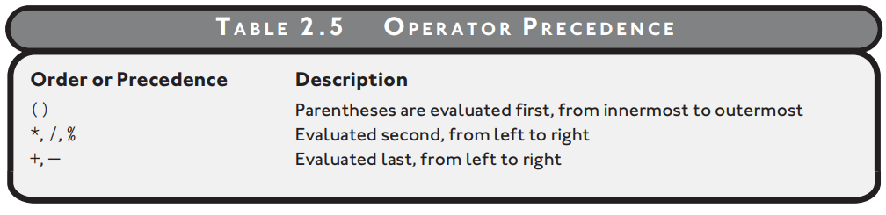
Remind me in next class about this ….

Slide 20
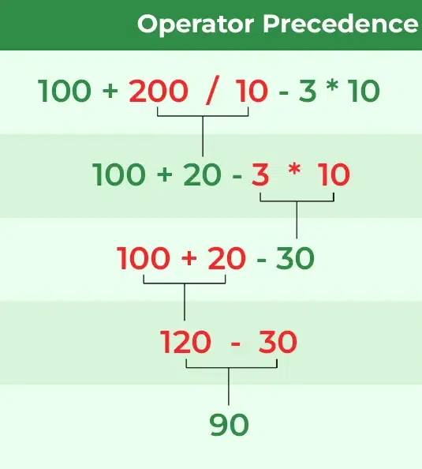
precedence

Slide 21
C doesn’t provides any exponential operator ,
so a² can’t be expressed as a^2 ,
but instead a² is expressed as a*a

Slide 22
Example code
Practice code using variables of type int , float
Practice code using different mathematical expression using arithmetic expressions
Practice code using variables ,constants …..

Slide 23
Home TASK
Learn and practice all code that has been taught , try different scenarios, equations ,explore errors .
Try writing code for the flow charts and pseudocodes that were given in assignments , you may be needing some thing that has not been taught yet explore it.
From next week I assume that you know how to write and execute code without any excuses , Also I would assume you have learnt every thing that has been taught !
Get comfortable with syntax of C from now onward , practice following on page then in editor .
S=vt+1/2 at^{2 ,} Find S ?
2as =vf²-vi² , Find a ?
vf=vi+at , Find t ?
F= ma , Find F ?
Code for Pythagoras theorem ?

Slide 24



THANK YOU

